Slide 1
TWG Agroecology and sustainable yields
20 February 2020
Brussels

Slide 2
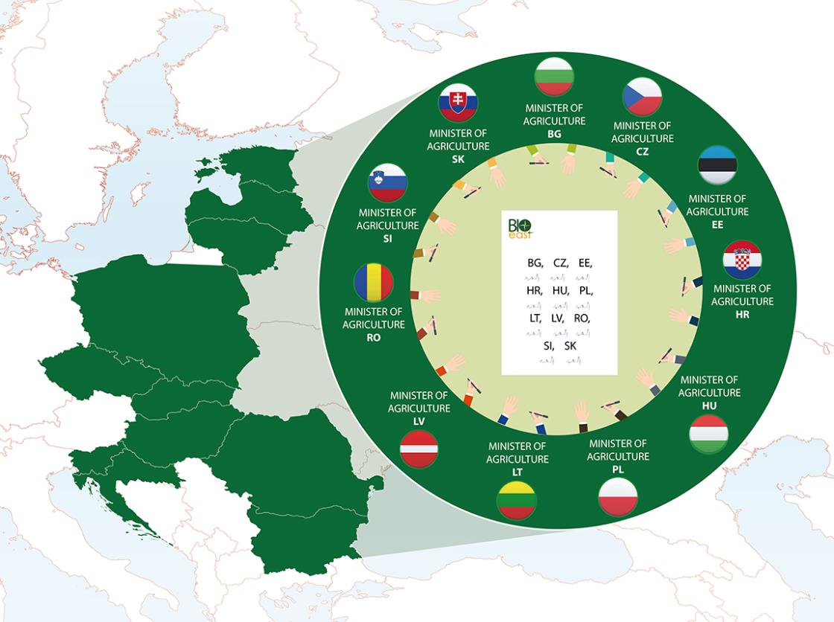
TWG Agroecology and Sustainable Yields
Thematic Working Group on Agroecology and Sustainable Yields
Coordinated by the Hungarian Ministry of Agriculture and ÖMKi
Strategic Research and Innovation Agenda (SRIA)

Slide 3
Aim of the session
To introduce and inform the member states representatives about the future research and innovation priorities and funding schemes of the next Horizon Europe framework program with specific regard to soil, agroecology and sustainable intensification of the production.

Slide 4
The programme today II.
12:30-15:00 Closed session for TWG members – Kick-off meeting of the AE TWG
Aim of the closed session:
TWG members will discuss the group’s terms of reference, action plan in the context of the future BIOEAST Strategic Research and Innovation agenda

Slide 5
The programme today I.
Open session
09:15 – 09:30 Soil health and food mission Alexia ROUBY, officer, DG AGRI
09:30 – 09:45 European Partnership “Accelerating farming systems transition: agro-ecology living labs and research infrastructures”Susana GAONA-SAEZ, officer, DG AGRI
09:45 – 10:00 Novelties around EIP-AGRI, multi-actor approach and AKIS in the future CAP Inge van OOST, officer, DG AGRI
10:00 – 10:30 Panel discussion and Q&A
10:30 – 10:45 Coffee break
10:45 – 11:00 Agriculture in the context of Horizon Europe Alexia ROUBY, officer, DG AGRI
11:00 – 11:15 Yields and sustainable intensification, outlook of agriculture Robert M’BAREK, team leader, JRC
11-15 – 11:30 Panel Discussion and Q&A

Slide 6
Thank you & LET‘S START!

